Slide 1



SCHOOL NAME
CONTINUING EDUCATION
IN NURSING
a foundation for safe, effective, and modern practice

Slide 2


CONTENTS
What continuing education is
Benefits for patients
Benefits for professionals
PART 1
Types of continuing education
Alternative options
Barriers to attending continuing education
PART 2

Slide 3

PART 1
CONTEXT AND BENEFITS

Slide 4

WHAT IS
continuing education?
Continuing education (CE) in nursing refers to learning opportunities beyond basic training, such as nursing programs and professional development.

Slide 5

BENEFITS
for patients
Improved quality care
Fewer medical errors
Better health outcomes

Slide 6

BENEFITS for professionals
Maintains licensure and certifications
Enhances clinical skills and knowledge
Supports career advancement

Slide 7

APPLICATION AND BARRIERS
PART 2

Slide 8



TYPES Of
continuing education
Annual healthcare employee requirements
State- or country-mandated nurse CE
Professional development activities

Slide 9
TYPES Of
continuing education
Continuing education for nurses can be delivered in a variety of formats:
Conferences
Live classes
Online classes
Online and live webinars
Self-study educational packets

Slide 10
ALTERNATIVE WAYS TO FULFILL NURSING
CE requirements
Some countries offer alternative methods for completing CE. Always check with an official organization to confirm what’s approved.
Academic courses
In-service training
Publishing
Volunteering

Slide 11
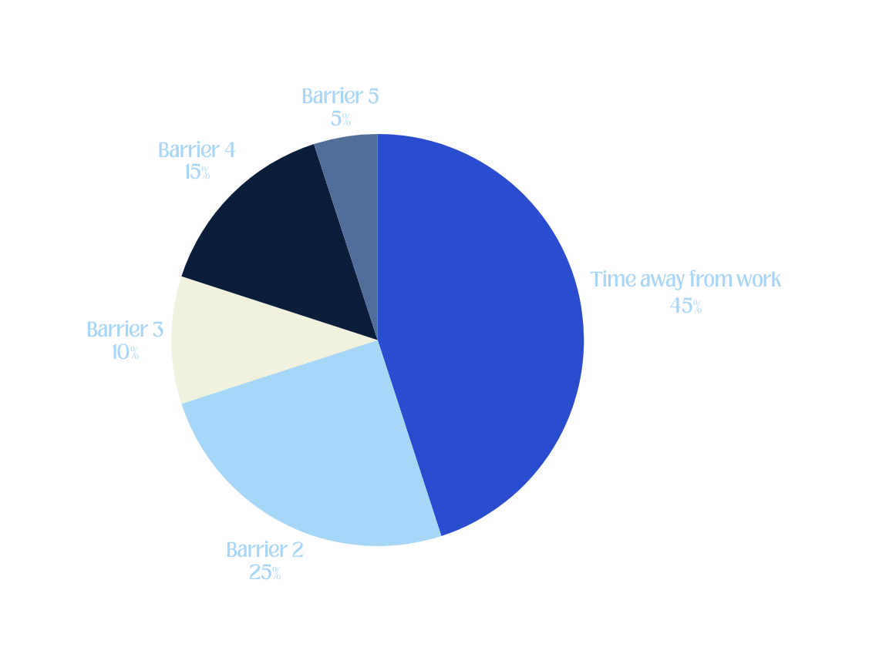
BARRIERS TO ATTENDING
CE across nursing roles
Context for the chart. Using the chart, highlight the three most common barriers. Wrap up with a takeaway that leads into the next slide.

Slide 12
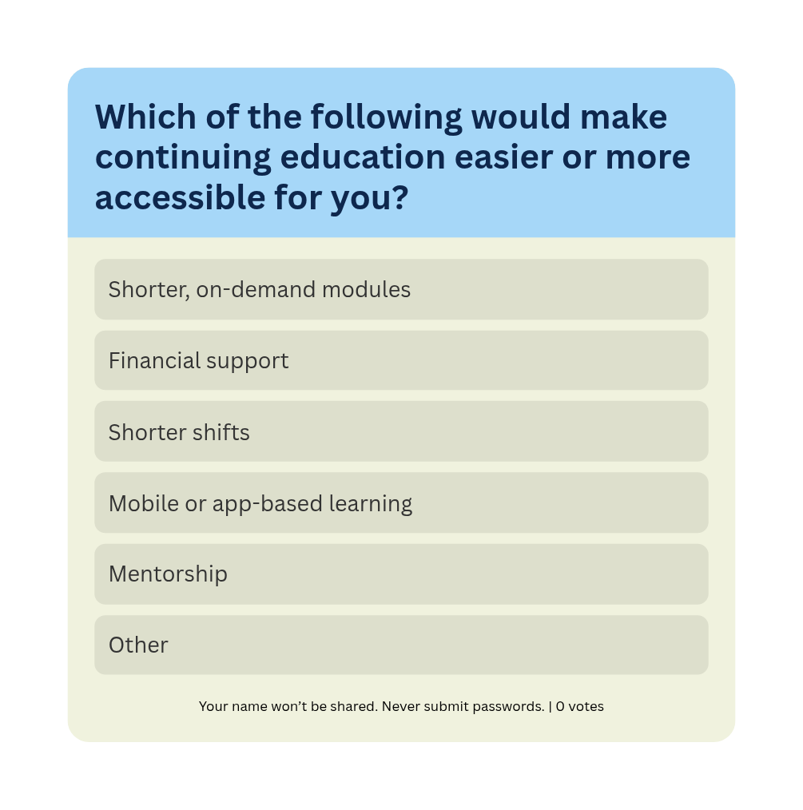
CHEck-in poll
Choose the option that best applies to your situation, or add your own suggestion.
Share your answer with your lead or a peer.

Slide 13

SUMMARY
ABOUT CONTINUING EDUCATION
Continuing education (CE) equips nurses to deliver safer, more effective, and modern care.
It helps maintain licensure, fuels career growth, and enhances clinical skills.
TYPES AND BARRIERS
CE comes in many forms: webinars, workshops, certifications, and workplace learning.
Time, cost, and lack of support remain real barriers across roles.

Slide 14
RESOURCE PAGE
Use these in your presentation. Delete or hide this page before presenting.
FONTS
DESIGN ELEMENTS / ICONS
This presentation template
uses the following free fonts:
TITLES:
LOUBAG
BODY TEXT:
Roca Two Regular
You can find these fonts online too.
COLORS
#0A1D3B
#2A4DCF
#A6D7F8
#F0F2DE
#FFF

Slide 15

CREDITS
This presentation template is free for everyone to use, thanks to the following:
for this presentation template
Pexels, Pixabay, Sketchify
for the photos, graphics, and elements
HAPPY DESIGNING!

Slide 16
B for blur | C for confetti
D for a drumroll | M for mic drop
O for bubbles | Q for quiet
U for unveil | Any number from 0-9 for a timer
RESOURCE PAGE
Find the magic in presenting. Select these keys while in Present mode.
Delete or hide this page before presenting.

